Slide 1

Investors’ Conference Call
11 May 2025, Kingdom of Bahrain

Slide 2
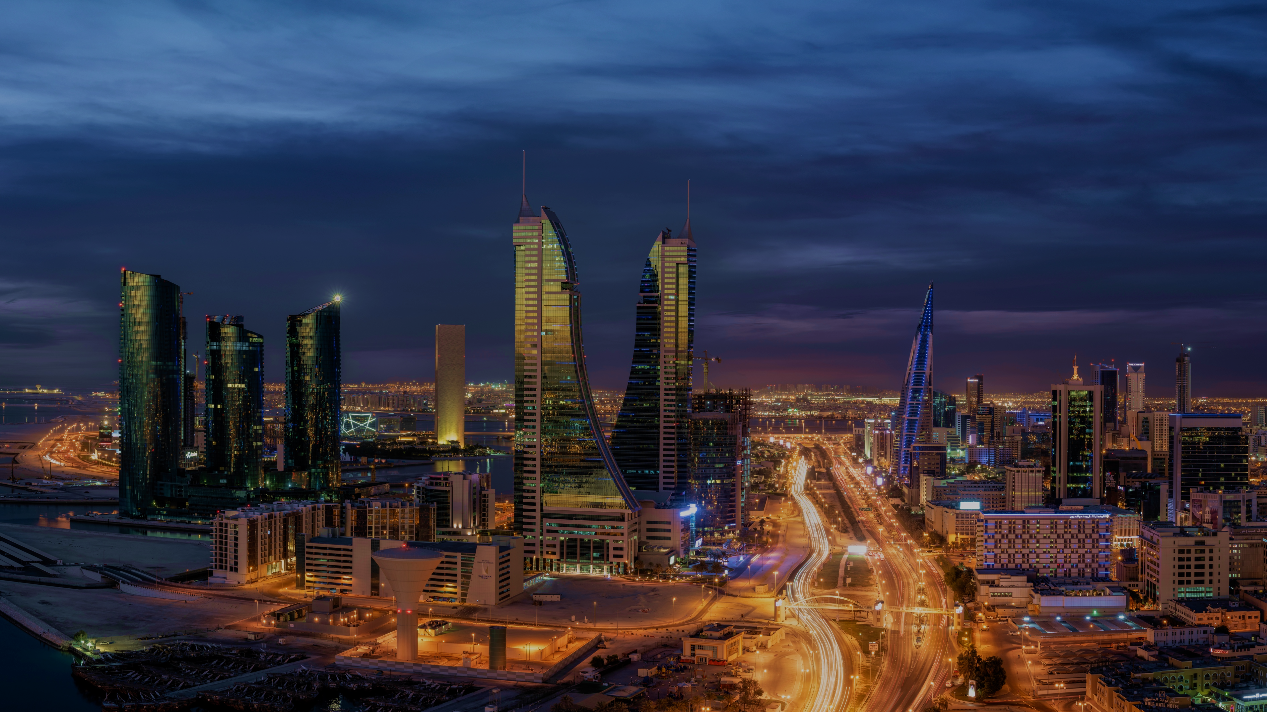

Corporate and
Strategic Developments

Slide 3


Corporate Highlights
The Board approved the BBK strategy and business plan for the years 2025-2027.
The Bank achieved a record quarterly results in NI for Q1-2025
Fitch Ratings has affirmed BBK Long-Term Issuer Default Rating (IDR) at 'B+' with a Negative Outlook, capped by the domestic operating environment.
The Bank successfully acquired HSBC Bahrain Retail portfolio with targeted transition this year, subject to CBB final approval
BBK continues to progress its discussions and negotiations on the potential merger with NBB.
The Bank secured a no-objection from JP Morgan to perform "downstream" USD correspondent activities for Singapore Gulf Bank.
BBK provided a BHD 58 Mil Shari’a Compliant financing to facilitate Solidarity Group Holding acquisition of BNI Bahrain.

Slide 4
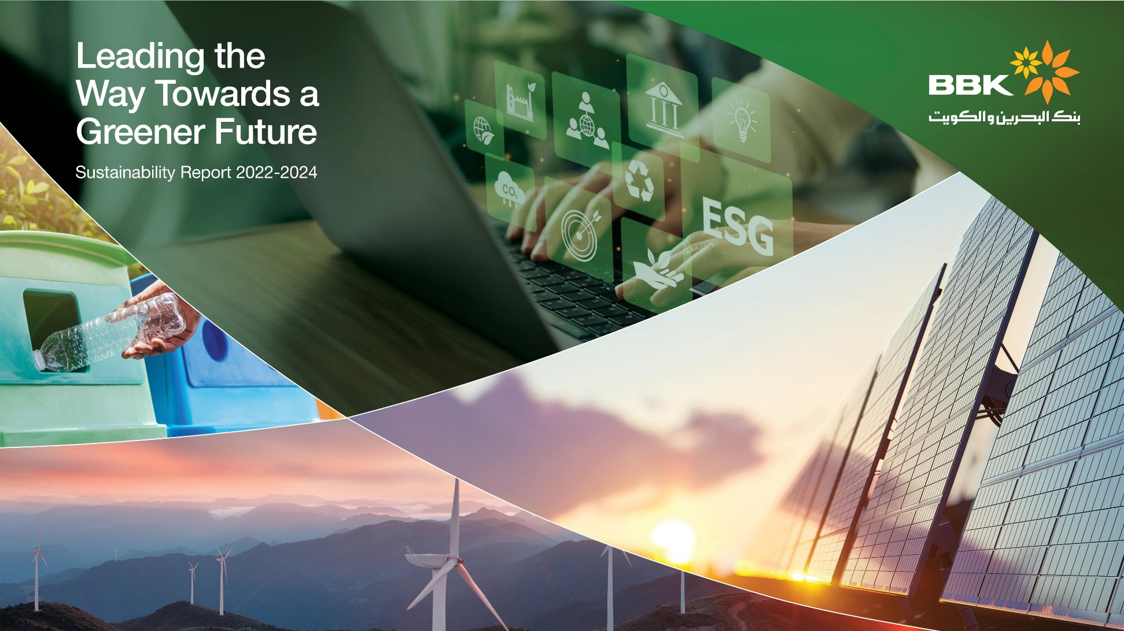




Sustainability
Launched a comprehensive Sustainability Report for the 2022-2024 cycle, showcasing our commitment to environmental, economic, and social responsibility.
Sustainability Highlights
50%
30%
75.4
42%
4,916.42
29,253.65
Independent Directors (%)
Female Board Members (%)
Customer Net Promoter Score
Female Employees (%)
GHG Emissions (MT CO₂e)¹
Energy Consumption (GJ)
Zero
50%
2.2M
67.2
22%
76,708.97
Corruption Incidents (#)
Independent
directors (%)
Community Investments (BHD)
Training Hours (Average for FTE)
Growth in the Number of Clients Benefiting from ESG Products (%)
Water Consumption (M3)
Looking Ahead
Our updated sustainability objectives are now aligned with the CBB’s ESG Requirements Module, ensuring that our goals and performance meet both national and international standards.
Looking ahead, our goals are to foster growth and innovation by:
Reducing our carbon footprint
Promoting green finance
Enhancing social responsibility
Improving employee engagement
1- Includes scopes 1 and 2 and selected categories of Scope 3, using the GHG Protocol.

Slide 5

Financial Performance

Slide 6



Financial Performance
11%
(BD Millions)
4%
4%
Net Profit
54%
BD 21m
15%
Increase by 4%
31 Mar 2025
31 Mar 2024
Investors’ Conference Call I 11 May 2025

Slide 7
Financial Position
7%
(BD Millions)
0.3%
Total Assets
7%
BD 4,485m
4%
Increase by 7%
31 Mar 2025
31 Dec 2024
Investors’ Conference Call I 11 May 2025

Slide 8
Indicators
Proﬁtability |  |  | Mar 2025 | Dec 2024
 | Return on Average Equity* | % | 13.2 | 11.7
 | Return on Average Assets* | % | 1.9 | 1.8
 | Earnings per share* | BHD | 0.046 | 0.040
 | Cost/Income | % | 40.3 | 44.3
Assets Quality | Speciﬁc Coverage Ratio | % | 66.3 | 65.1
 | ECL (Stage 1&2) Coverage Ratio | % | 1.3 | 1.4
 | Gross NPL/ Gross Loans | % | 4.1 | 4.2
Regulatory Ratios | CAR | % | 22.8 | 26.5
 | NSFR | % | 130.8 | 142.0
 | LCR | % | 230.0 | 268.5
* Annualized
Investors’ Conference Call I 11 May 2025

Slide 9
Thank you
11 May 2025, Kingdom of Bahrain

